Slide 1



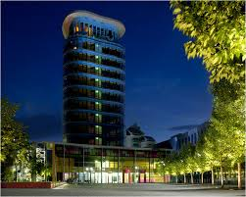

INTERNATIONAL STUDENTS EVENT PORTAL
Project 4 - Team 2
Rakshit Siddalingappa - 11012530
Mentored By,
Prof. Dr. Gerd Moeckel
Dr. Josef Hermanns

Slide 2
Table of contents
Introduction
Target State
Project Structure Plan
Project Flow
Stakeholder‘s Analysis
SWOT Analysis
Technical Analysis

Slide 3
INTRODUCTION
Aims to design a International Students Events Portal with the purpose of providing necessary services for international students.
Consolidated platform for users of important information for the initial days of their arrival.
Problem statement
Less information in the SRH University website for international students & No real time update of any of the events.
No information about the activities & Other services around the SRH University.
Slide 3

Slide 4
Target state
Basic Information for all of the International Students like,
City Registrations, Bank Info, Sight seeing, Route Maps.
Information of all the Supermarkets & Restaurants.
Events information in & around the University.
Academic Information with respect to all the Universities in Germany.

Slide 5
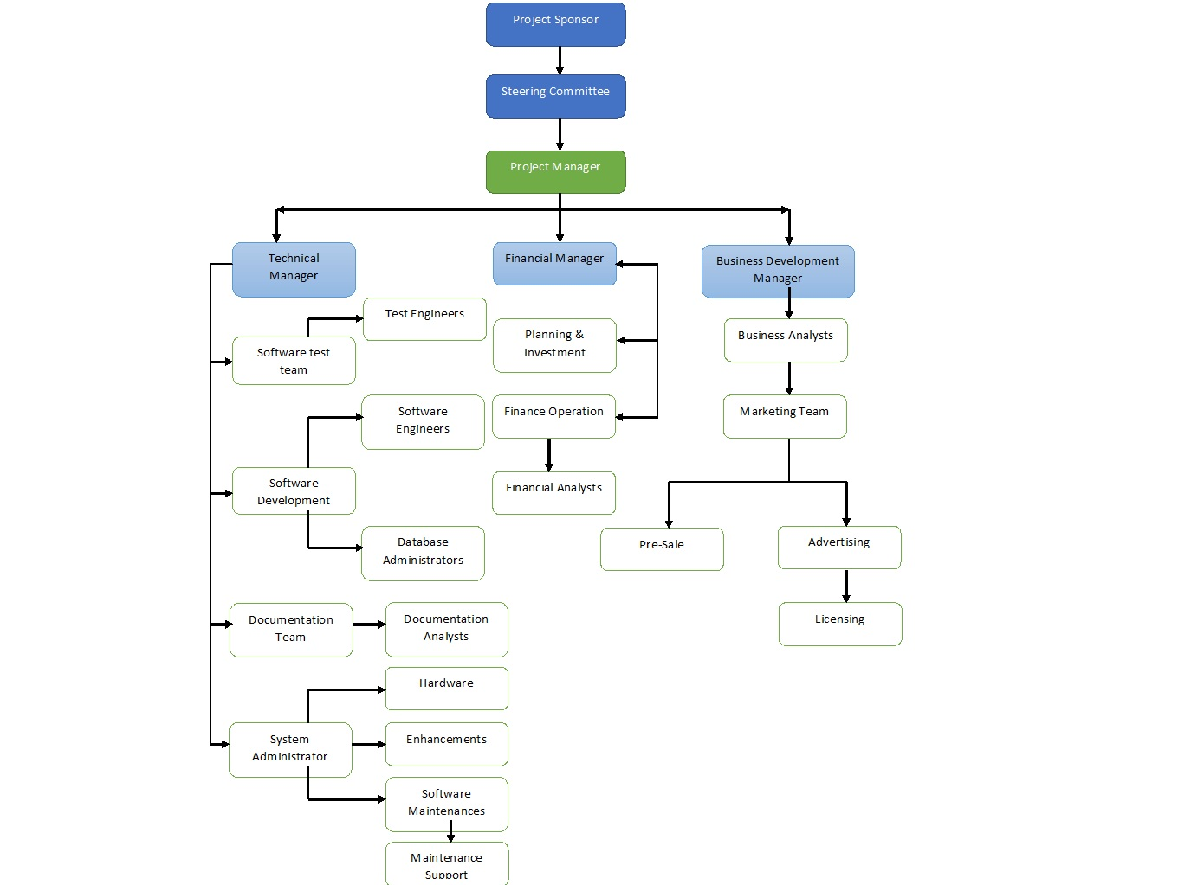
Project structure plan

Slide 6
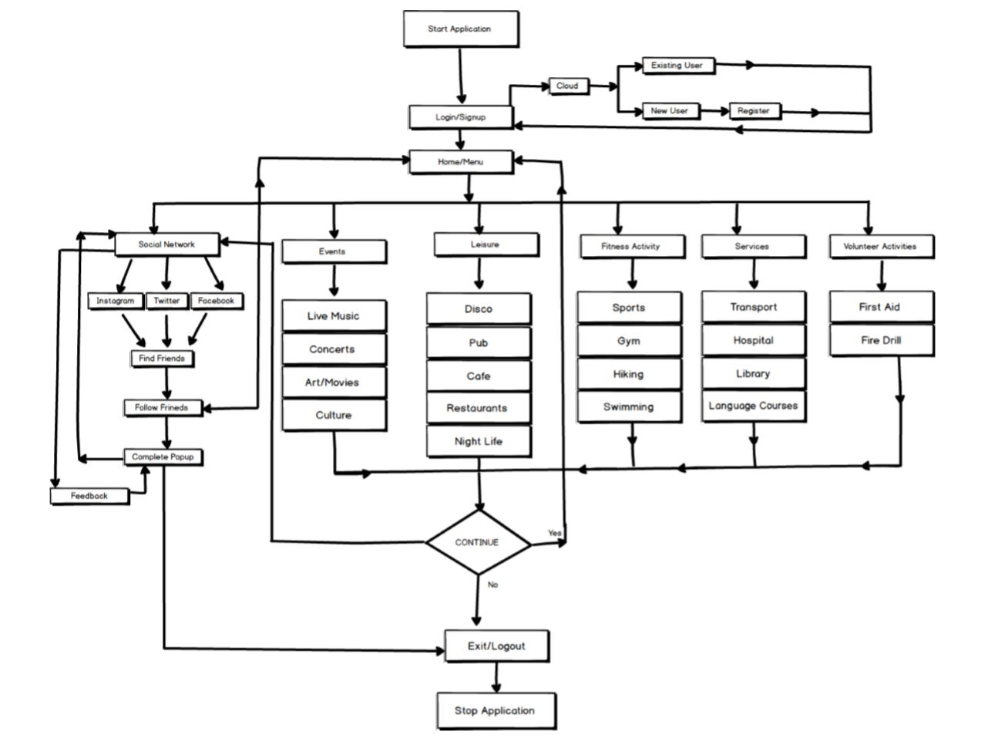
Project flow

Slide 7
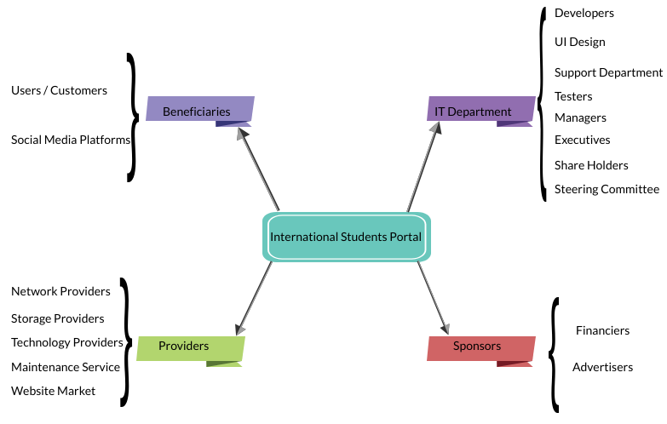
Stakeholder‘s analysis

Slide 8
Swot analysis
Strengths,
International Students Events Portal, Multifunctional, Data Security.
Opportunities,
International Recognition, Number of Users, New Services.
Weakness,
Marketing Skills, Offline Unofficial Events.
Threats,
Competitors, Government Laws & Regulations.

Slide 9
Technical Analysis
User Profile,
Login / Signup, User Information, Enquiry.
Website Profile,
Information on website, Error Detection, SEO.
Cloud,
Cloud Data Storage.
Social Network.
Navigation of the Events / Activities.

Slide 10
Thank you!

